Slide 1
Pantry Chef: Requirements Specification
Ashton Hull, Braxton Wilson, Jacob Lethola, Tyler Gilbert

Slide 2
Summary of the Project Idea
Pantry Chef is a mobile app that aims for the android platform. The app will have three main components a mobile pantry, adding ingredients to the pantry with manual search or through barcode scanning, and recipe lookup and recommendations based on the ingredients the user has in the pantry. The primary goals of the app are to simplify meal planning and keeping track of food that the user owns and needs to buy.

Slide 3
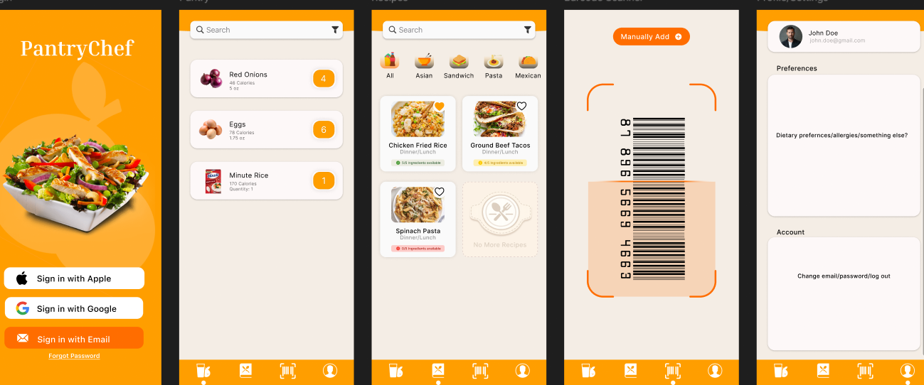
App Mockup

Slide 4
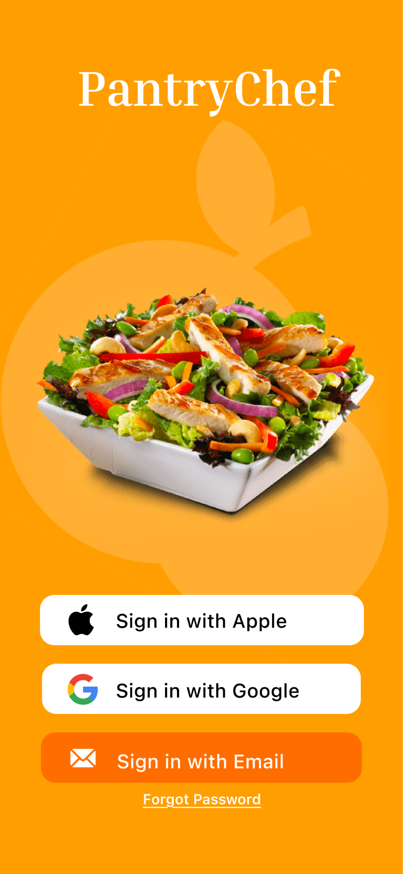
Onboarding:
The login/registration form will be a single page with the following elements:
Title text of “Pantry Chef”.
Header text of “Sign up with Google”.
A button to sign in with Google.
Barcode Scanner:
3.2 The barcode scanner has a live view of
the phone’s rear camera:
The app will constantly scan for barcodes.
When a barcode is found, a card will be displayed with the information found from the scanned ingredient.

Slide 5
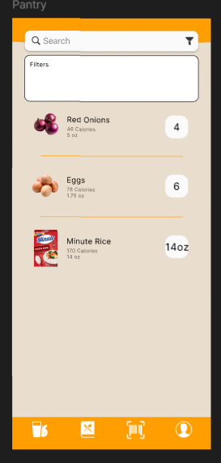
Pantry View:
4.1: The ingredients page will have a search bar with a filter button at the top of the screen.
4.1.1 Search bar with have a placeholder of “Search”
4.1.2 The search bar will allow the user to search for ingredients currently in the pantry or that are out of stock but were in the pantry in the past.
4.1.3 The filter button, when pressed, will load the options “In Stock”, “Out of Stock”, “Priority”, “Reserved.”
4.1.3.1: After applying the filter, the list of ingredients updates to show ingredients with the corresponding label
4.2: Under the search, a list of ingredients currently in the pantry will be displayed
4.2.1: Each ingredient will display the name of the ingredient and under the number of calories and amount of food per serving will be displayed
4.2.2: Each ingredient will have a number displayed that shows the amount stored in the pantry

Slide 6
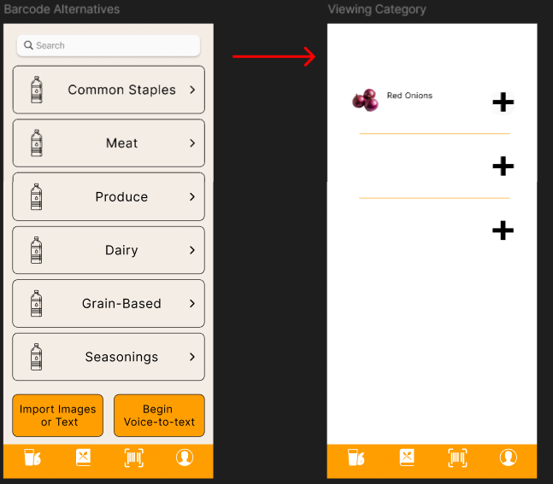
Manual Ingredient Adding:
5.2: Below the search bar there will be buttons with different labels so the user can more quickly search without having to use the search bar
5.2.1: The buttons will be labeled “Meat”, “Produce”, “Dairy”, “Grain-Based”, “Seasonings”
5.2.1.1: Once clicked on a button redirect to another page with a list of ingredients listed that fit the description with a plus sign next to the ingredient listed.
5.2.1.2: After clicking the plus sign, the app will redirect users to the edit information and confirm page to add the ingredient to the pantry

Slide 7
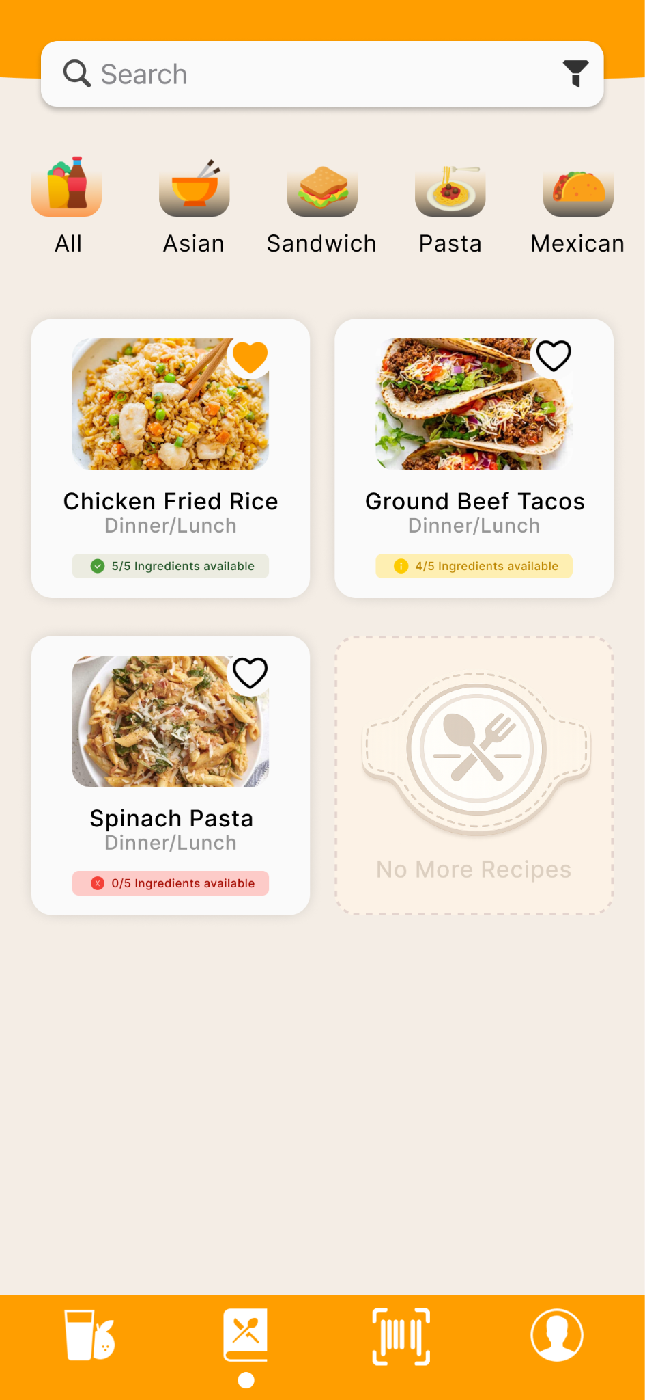
Recipes Page
At the top of the page, a search bar allows users to enter text, dynamically updating the list of recipe cards as they type, and the system’s touch keyboard collapses when the user taps or swipes away.
Below the search bar, a collection of ellipse-shaped filter tag elements with text representing recipe categories allows users to filter the recipe cards to display only matching results when selected.
Beneath the filter tags, a scrollable series of recipe cards displays the recipe title, an image of the finished dish, and a brief description, and selecting a card transitions the user to the Recipe Reader.
A navigation bar is present at the bottom of the page.

Slide 8
Recipes Reader
no ui mockup :(
Recipes Reader
The Recipe Reader displays an image of the finished recipe at the top.
Below the image and title, a paragraph text element presents the recipe description.
Beneath the description, a list of ingredients is shown, with each ingredient indicating whether it is present in the user’s pantry.
At the bottom of the recipe view, a button allows the user to mark the recipe as completed when selected.
The user can return to the recipe selection page by swiping left from the edge of the screen.
A navigation bar is present at the bottom of the page.

Slide 9
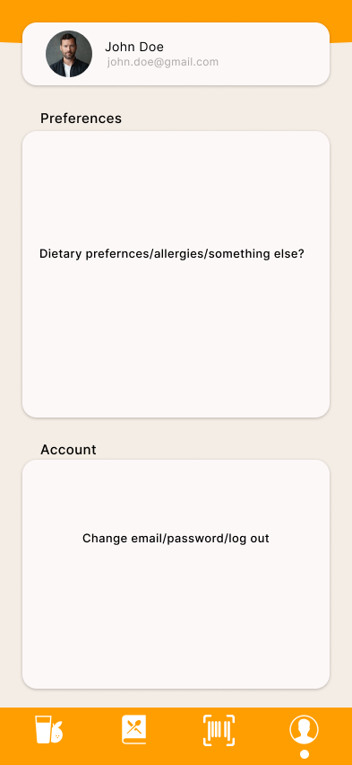
Profile View
The profile home page will have a section containing the users first and last name, profile picture, and email address
Below the profile card will be a preferences section for things like adjusting notification settings, adding dietary restrictions, adding favorite cuisines, etc.
Below the preferences section will be an account section where the user may edit their account details, sign out, change password, edit profile picture, and even view their recipe history.

Slide 10


A Risky Requirement
New technologies: React Native
Most team members don’t have experience with React Native or Expo.
Some team members don’t have experience with mobile app development.

Slide 11
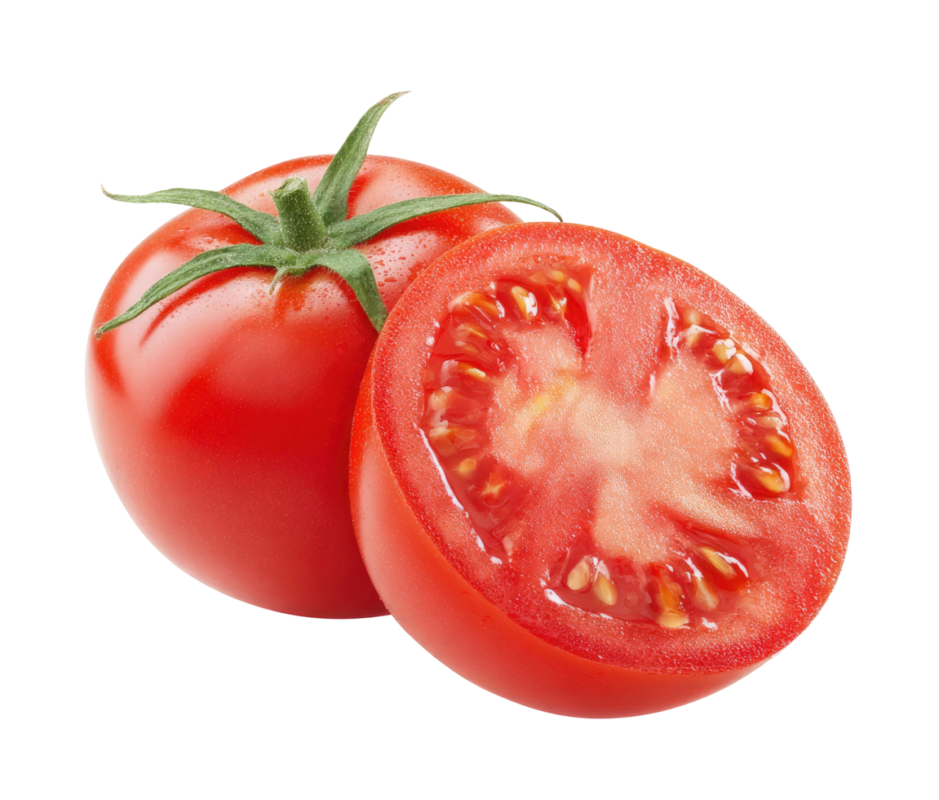
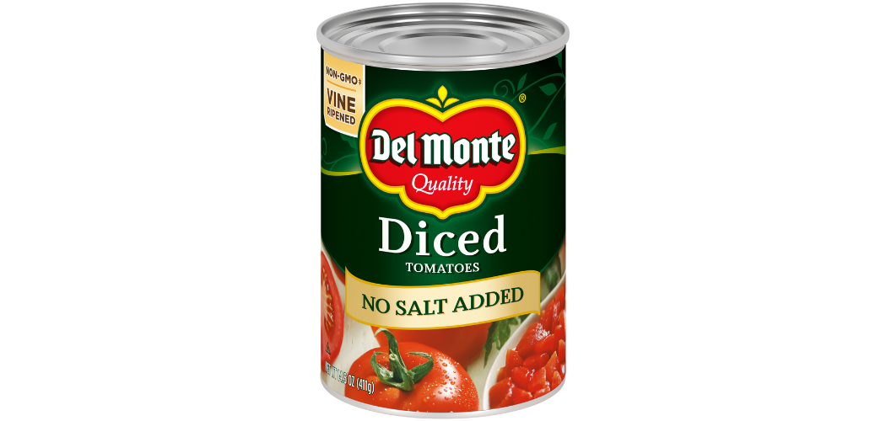
Another Risky Requirement
Potential Hurdle: Ingredient Normalization
Normalizing one ingredient with a different but functionally identical ingredient is an integral feature of the app, and necessary for proper use.
The Spoonacular API we will use has some built-in functionality for ingredient normalization, but depending on exact circumstances we may need to implement our own normalization or guardrails to ensure proper function.
VS.

Slide 12
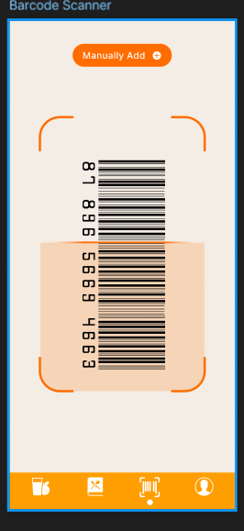
Last Risky Requirement
Barcode Scanning:
Products may use different barcode standards (UPC, EAN, QR, etc.), which can introduce inconsistencies in how data is read and processed.
These variations can make it more challenging to accurately map a scanned barcode value to the correct product in the system.

Slide 13
Questions?

